Slide 1
Hướng dẫn trình bày Poster
Kích thước poster:
A0 đứng - 1189 mm x 841 mm (46.8” x 33.1”)
Chữ trình bày trong poster
  Nên sử dụng những font thông dụng, rõ ràng, dễ nhìn
  Font size tối thiểu 24
Thiết kế đề mục trong poster
  Dựa trên những nội dung trong paper (Abstract, Introduction, Materials and Methods, Results and Discussion, Conclusion…)
  Linh hoạt trong việc bố trí các nội dung, chọn lựa màu sắc
  Ví dụ
  Slide 2 là 1 scientific poster template (A0 portrait) download từ internet. Ưu điểm là có sẵn bố cục và định dạng kích thước chuẩn A0
  Tùy đề tài và sự sáng tạo của mỗi người sẽ tạo ra sản phẩm của riêng mình (minh họa ở slide 3)
In ấn
  Poster hoàn chỉnh sẽ in màu 1 bảng A0 (để trưng bày) và 10 bảng A4 (trắng đen hoặc màu để trong hole file bag)

Slide 2


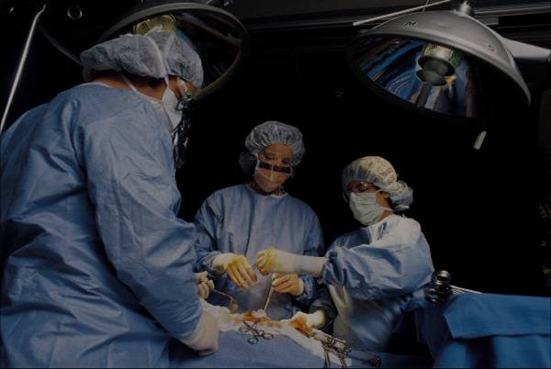
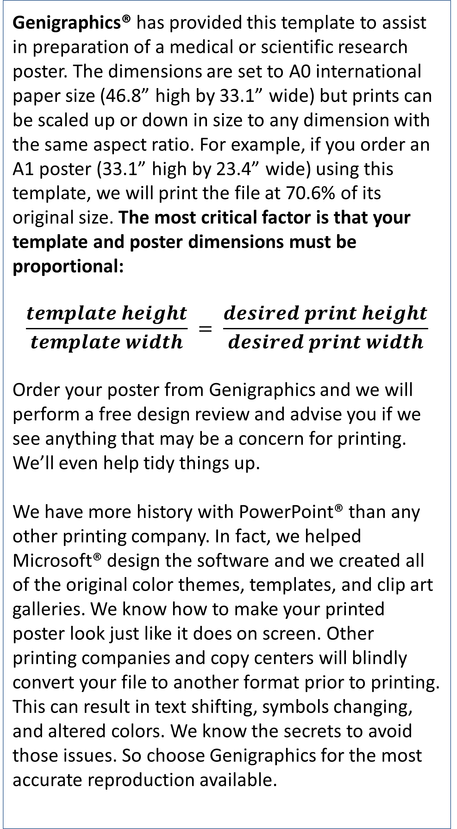
The 3rd ENFO Student Research Workshop (ENFO-SRW)
Template Provided By Genigraphics – 800.790.4001
Replace This Text With Your Title
John Smith, MD¹; Jane Doe, PhD²; Frederick Jones, MD, PhD^{1,2}
¹University of Affiliation, ²Medical Center of Affiliation
Abstract
Methods and Materials
Click here to insert your Abstract text. Type it in or copy and paste from your Word document or other source.
This text box will automatically re-size to your text. To turn off that feature, right click inside this box and go to Format Shape, Text Box, Autofit, and select the “Do Not Autofit” radio button.
To change the font style of this text box: Click on the border once to highlight the entire text box, then select a different font or font size that suits you. This text is Calibri 30pt and is easily read up to 4 feet away on an A0 poster.
Zoom out to 100% to preview what this will look like on your printed poster.
Click here to insert your Methods and Materials text. Type it in or copy and paste from your Word document or other source.
This text box will automatically re-size to your text. To turn off that feature, right click inside this box and go to Format Shape, Text Box, Autofit, and select the “Do Not Autofit” radio button.
To change the font style of this text box: Click on the border once to highlight the entire text box, then select a different font or font size that suits you. This text is Calibri 30pt and is easily read up to 4 feet away on an A0 poster.
Zoom out to 100% to preview what this will look like on your printed poster.
Chart 1. Label in 24pt Calibri.
Introduction
Results
Discussion
Genigraphics® has provided this template to assist in preparation of a medical or scientific research poster. The dimensions are set to A0 international paper size (46.8” high by 33.1” wide) but prints can be scaled up or down in size to any dimension with the same aspect ratio. For example, if you order an A1 poster (33.1” high by 23.4” wide) using this template, we will print the file at 70.6% of its original size. The most critical factor is that your template and poster dimensions must be proportional:
$$\frac{template height}{template width} = \frac{desired print height}{desired print width}$$
Order your poster from Genigraphics and we will perform a free design review and advise you if we see anything that may be a concern for printing. We’ll even help tidy things up.
We have more history with PowerPoint® than any other printing company. In fact, we helped Microsoft® design the software and we created all of the original color themes, templates, and clip art galleries. We know how to make your printed poster look just like it does on screen. Other printing companies and copy centers will blindly convert your file to another format prior to printing. This can result in text shifting, symbols changing, and altered colors. We know the secrets to avoid those issues. So choose Genigraphics for the most accurate reproduction available.
Click here to insert your Results text. Type it in or copy and paste from your Word document or other source.
This text box will automatically re-size to your text. To turn off that feature, right click inside this box and go to Format Shape, Text Box, Autofit, and select the “Do Not Autofit” radio button.
To change the font style of this text box: Click on the border once to highlight the entire text box, then select a different font or font size that suits you. This text is Calibri 30pt and is easily read up to 4 feet away on an A0 poster.
Zoom out to 100% to preview what this will look like on your printed poster.
Speaking of Results, yours will look better if you remember to run a spell-check on your poster! After you’ve added your content click on Review, Spelling, or press F7.
Click here to insert your Discussion text. Type it in or copy and paste from your Word document or other source.
This text box will automatically re-size to your text. To turn off that feature, right click inside this box and go to Format Shape, Text Box, Autofit, and select the “Do Not Autofit” radio button.
To change the font style of this text box: Click on the border once to highlight the entire text box, then select a different font or font size that suits you. This text is Calibri 30pt and is easily read up to 4 feet away on an A0 poster.
Zoom out to 100% to preview what this will look like on your printed poster.
Conclusions
Click here to insert your Conclusions text. Type it in or copy and paste from your Word document or other source.
This text box will automatically re-size to your text. To turn off that feature, right click inside this box and go to Format Shape, Text Box, Autofit, and select the “Do Not Autofit” radio button.
To change the font style of this text box: Click on the border once to highlight the entire text box, then select a different font or font size that suits you. This text is Calibri 30pt and is easily read up to 4 feet away on an A0 poster.
Zoom out to 100% to preview what this will look like on your printed poster.
Table 1. Label in 24pt Calibri.
 | Heading | Heading | Heading
Item | 800 | 790 | 4001
Item | 356 | 856 | 290
Item | 228 | 134 | 238
Item | 954 | 875 | 976
Item | 324 | 325 | 301
Item | 199 | 137 | 186
Figure 1. Label in 24pt Calibri.
Figure 2. Label in 24pt Calibri.
Contact
References
<your name>
<your organization>
Website:
Phone:
Email:
Cell phone:

Slide 3
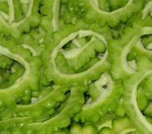
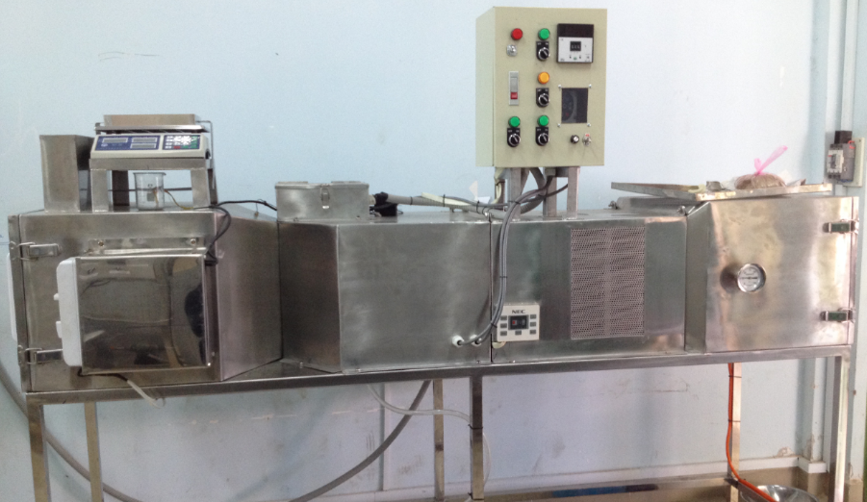
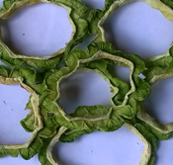
The 3rd ENFO Student Research Workshop (ENFO-SRW)
Drying Kinetics of Low-temperature Microwave-assited Drying of sliced Bitter Melon (Momordica charantia L.)
Linh T.V. Nguyenª, Duy P.B. Nguyen^{b}, Cuong X. Luuª and Phong T. Huynh^{b}
ªNguyen Tat Thanh University, ^{b}Bach Khoa University (Ho Chi Minh city, Vietnam)
Purposes of Study
Results
- Effects of Mirowave powers on Drying curves; Drying rate curves
- Finding the best model fits the experimental data
- Determination of the diffusivity values
Methods and Materials
The result revealed that higher power of microwave was the shorter drying drying time was
Materials: Fresh bitter melons (Momordica charantia L.) is 13.74 kg water / kg dried matter with 5 mm thickness.
The bioactive compounds
Used as
a medicinal food
Create therapeutic effects
Chart 1. Moisture content at different power levels of micorwave
(Tan et al., 2016)
Second
stage
First stage
* First stage: Evaporation controlled
* Second stage: Diffusion controlled
* Last stage:
Bond breakup
Microwave
Last
stage
Input Air
Condenser
Dry Air
Drying chamber
Output Air
Moisture
Low-
Temperature
Micrwoave-
assisted
Drying
Chart 2. Drying rate curves at different power levels of micorwave
Table 2. The results of non-linear regression analyis in low-temperature drying assisted microwave of bitter melon slices at different output
Powers | Model | R² | RMSE | χ²
450W | Page | 0.99621 | 0.01657 | 0.00031
 | Henderson and Pabis | 0.99271 | 0.02298 | 0.00059
 | Logarithm | 0.99275 | 0.02292 | 0.00063
 | Midilli | 0.99907 | 0.00823 | 0.00009
 | Wang and Singh | 0.91246 | 0.07965 | 0.00714
300W | Page | 0.99196 | 0.02424 | 0.00064
 | Henderson and Pabis | 0.99158 | 0.02479 | 0.00067
 | Logarithm | 0.99232 | 0.02369 | 0.00064
 | Midilli | 0.99611 | 0.01686 | 0.00034
 | Wang and Singh | 0.94457 | 0.06363 | 0.00442
150W | Page | 0.99820 | 0.01245 | 0.00017
 | Henderson and Pabis | 0.99316 | 0.02427 | 0.00063
 | Logarithm | 0.99939 | 0.00727 | 0.00006
 | Midilli | 0.99967 | 0.00537 | 0.00003
 | Wang and Singh | 0.99497 | 0.02083 | 0.00047
Midilli model is the best model
Figure 1. Low-temperature drying assisted microwave principle and equipment
Methods and Materials
Experimental Setup:
- Maximum power output of 750 W at 2450 MHz
- A 360⁰ rotatable dish with 4 rpm inside the microwave drying chamber
Drying process:
- There are 3 levels of microwave power (150W, 300W, 450W)
- The samples were dried assisted-microwave in 10 minutes and took rest in 2 minutes
Chart 3. Comparison of experimental and predicted moisture ratios using the Midilli model for bitter melon slices at different output microwave power
Table 3. Values of effective diffusivity obtained for bitter melon slices at different microwave powers
Microwave powers, P (W) | Effective diffusivity, D_{eff} (m²/s) | The coefficient of determination, R²
450 W | 12.0741x10⁻¹⁰ | 0.9750
300 W | 8.6123x10⁻¹⁰ | 0.9699
150 W | 6.8814x10⁻¹⁰ | 0.9592
Table 1. Mathematical modes were used to predict moisture ratios of bitter melon slices
No | Model Names | Equations | References
1 | Page model | MR = exp(-kt^{n}) | Sarimeseli, 2011
2 | Henderson and Pabis model | MR = aexp(-kt) | Akpinar et al., 2006
3 | Logarithm model | MR = aexp(-kt)+c | Yaldiz et al., 2001
4 | Wang and Singh model | MR = 1 + at + bt² | Soysal et al., 2006
5 | Midilli model | MR = aexp(-kt^{n}) + bt | Özbek & Dadali, 2007
Conclusions
Using microwave to dry bitter melon at low temperature plays a key role to force moisture out of the material and separate moisture diffusion from center to surface. The higher power reduces drying time, yet increases drying velocity and D_{eff}. Among five common investigated mathematical models, Midilli model showed the best result comparing with experimental data. Our result emphasizes that the kinetic of low-temperature microwave-assisted drying has three phaces. It initiates with evaporation controlled, following by diffusion controlled, and finish with the bond breakup.
Contact
References
NGUYỄN THỊ VÂN LINH
Faculty of Food, Chemical and Environmental Sciences
Nguyen Tat Thanh University, Ho Chi Minh City, Vietnam
Website: https://kttpmt.ntt.edu.vn/
Phone: (+84) 19002039 - ext. 409
Email: ntvlinh141@gmail.com / ntvlinh@ntt.edu.vn
Cell phone: (+84) 903570019
Akpinar, E. K. (2006). Determination of suitable thin layer drying curve model for some vegetables and fruits. J. Food Eng., 73, 75–84.
Özbek, B., & Dadali, G. (2007). Thin-layer drying characteristics and modelling of mint leaves undergoing microwave treatment. Journal of Food Engineering, 83(4), 541–549.
Sarimeseli, A. (2011). Microwave drying characteristics of coriander (Coriandrum sativum L.) leaves. Energy Conversion and Management, 52(2), 1449–1453.
Soysal, Y., Öztekin, S., & Eren, Ö. (2006). Microwave Drying of Parsley: Modelling, Kinetics, and Energy Aspects. Biosystems Engineering, 93(4), 403–413.
Yaldiz, O., Ertekin, C., & Uzun, H. I. (2001). Mathematical modeling of thin layer solar drying of sultana grapes. Energy, 26(5), 457–465.
Tan, S. P., Kha, T. C., Parks, S. E., & Roach, P. D. (2016). Bitter melon ( Momordica charantia L.) bioactive composition and health benefits: A review. Food Reviews International, 32(2), 181–202.

Slide 4
The 3rd ENFO Student Research Workshop (ENFO-SRW)
Template Provided By Genigraphics – 800.790.4001
Replace This Text With Your Title
John Smith, MD¹; Jane Doe, PhD²; Frederick Jones, MD, PhD^{1,2}
¹University of Affiliation, ²Medical Center of Affiliation
Abstract
Methods and Materials
Click here to insert your Abstract text. Type it in or copy and paste from your Word document or other source.
This text box will automatically re-size to your text. To turn off that feature, right click inside this box and go to Format Shape, Text Box, Autofit, and select the “Do Not Autofit” radio button.
To change the font style of this text box: Click on the border once to highlight the entire text box, then select a different font or font size that suits you. This text is Calibri 30pt and is easily read up to 4 feet away on an A0 poster.
Zoom out to 100% to preview what this will look like on your printed poster.
Click here to insert your Methods and Materials text. Type it in or copy and paste from your Word document or other source.
This text box will automatically re-size to your text. To turn off that feature, right click inside this box and go to Format Shape, Text Box, Autofit, and select the “Do Not Autofit” radio button.
To change the font style of this text box: Click on the border once to highlight the entire text box, then select a different font or font size that suits you. This text is Calibri 30pt and is easily read up to 4 feet away on an A0 poster.
Zoom out to 100% to preview what this will look like on your printed poster.
Chart 1. Label in 24pt Calibri.
Introduction
Results
Discussion
Genigraphics® has provided this template to assist in preparation of a medical or scientific research poster. The dimensions are set to A0 international paper size (46.8” high by 33.1” wide) but prints can be scaled up or down in size to any dimension with the same aspect ratio. For example, if you order an A1 poster (33.1” high by 23.4” wide) using this template, we will print the file at 70.6% of its original size. The most critical factor is that your template and poster dimensions must be proportional:
$$\frac{template height}{template width} = \frac{desired print height}{desired print width}$$
Order your poster from Genigraphics and we will perform a free design review and advise you if we see anything that may be a concern for printing. We’ll even help tidy things up.
We have more history with PowerPoint® than any other printing company. In fact, we helped Microsoft® design the software and we created all of the original color themes, templates, and clip art galleries. We know how to make your printed poster look just like it does on screen. Other printing companies and copy centers will blindly convert your file to another format prior to printing. This can result in text shifting, symbols changing, and altered colors. We know the secrets to avoid those issues. So choose Genigraphics for the most accurate reproduction available.
Click here to insert your Results text. Type it in or copy and paste from your Word document or other source.
This text box will automatically re-size to your text. To turn off that feature, right click inside this box and go to Format Shape, Text Box, Autofit, and select the “Do Not Autofit” radio button.
To change the font style of this text box: Click on the border once to highlight the entire text box, then select a different font or font size that suits you. This text is Calibri 30pt and is easily read up to 4 feet away on an A0 poster.
Zoom out to 100% to preview what this will look like on your printed poster.
Speaking of Results, yours will look better if you remember to run a spell-check on your poster! After you’ve added your content click on Review, Spelling, or press F7.
Click here to insert your Discussion text. Type it in or copy and paste from your Word document or other source.
This text box will automatically re-size to your text. To turn off that feature, right click inside this box and go to Format Shape, Text Box, Autofit, and select the “Do Not Autofit” radio button.
To change the font style of this text box: Click on the border once to highlight the entire text box, then select a different font or font size that suits you. This text is Calibri 30pt and is easily read up to 4 feet away on an A0 poster.
Zoom out to 100% to preview what this will look like on your printed poster.
Conclusions
Click here to insert your Conclusions text. Type it in or copy and paste from your Word document or other source.
This text box will automatically re-size to your text. To turn off that feature, right click inside this box and go to Format Shape, Text Box, Autofit, and select the “Do Not Autofit” radio button.
To change the font style of this text box: Click on the border once to highlight the entire text box, then select a different font or font size that suits you. This text is Calibri 30pt and is easily read up to 4 feet away on an A0 poster.
Zoom out to 100% to preview what this will look like on your printed poster.
Table 1. Label in 24pt Calibri.
 | Heading | Heading | Heading
Item | 800 | 790 | 4001
Item | 356 | 856 | 290
Item | 228 | 134 | 238
Item | 954 | 875 | 976
Item | 324 | 325 | 301
Item | 199 | 137 | 186
Figure 1. Label in 24pt Calibri.
Figure 2. Label in 24pt Calibri.
Contact
References
<your name>
<your organization>
Website:
Phone:
Email:
Cell phone:

Slide 5
The 3rd ENFO Student Research Workshop (ENFO-SRW)
Drying Kinetics of Low-temperature Microwave-assited Drying of sliced Bitter Melon (Momordica charantia L.)
Linh T.V. Nguyenª, Duy P.B. Nguyen^{b}, Cuong X. Luuª and Phong T. Huynh^{b}
ªNguyen Tat Thanh University, ^{b}Bach Khoa University (Ho Chi Minh city, Vietnam)
Purposes of Study
Results
- Effects of Mirowave powers on Drying curves; Drying rate curves
- Finding the best model fits the experimental data
- Determination of the diffusivity values
Methods and Materials
The result revealed that higher power of microwave was the shorter drying drying time was
Materials: Fresh bitter melons (Momordica charantia L.) is 13.74 kg water / kg dried matter with 5 mm thickness.
The bioactive compounds
Used as
a medicinal food
Create therapeutic effects
Chart 1. Moisture content at different power levels of micorwave
(Tan et al., 2016)
Second
stage
First stage
* First stage: Evaporation controlled
* Second stage: Diffusion controlled
* Last stage:
Bond breakup
Microwave
Last
stage
Input Air
Condenser
Dry Air
Drying chamber
Output Air
Moisture
Low-
Temperature
Micrwoave-
assisted
Drying
Chart 2. Drying rate curves at different power levels of micorwave
Table 2. The results of non-linear regression analyis in low-temperature drying assisted microwave of bitter melon slices at different output
Powers | Model | R² | RMSE | χ²
450W | Page | 0.99621 | 0.01657 | 0.00031
 | Henderson and Pabis | 0.99271 | 0.02298 | 0.00059
 | Logarithm | 0.99275 | 0.02292 | 0.00063
 | Midilli | 0.99907 | 0.00823 | 0.00009
 | Wang and Singh | 0.91246 | 0.07965 | 0.00714
300W | Page | 0.99196 | 0.02424 | 0.00064
 | Henderson and Pabis | 0.99158 | 0.02479 | 0.00067
 | Logarithm | 0.99232 | 0.02369 | 0.00064
 | Midilli | 0.99611 | 0.01686 | 0.00034
 | Wang and Singh | 0.94457 | 0.06363 | 0.00442
150W | Page | 0.99820 | 0.01245 | 0.00017
 | Henderson and Pabis | 0.99316 | 0.02427 | 0.00063
 | Logarithm | 0.99939 | 0.00727 | 0.00006
 | Midilli | 0.99967 | 0.00537 | 0.00003
 | Wang and Singh | 0.99497 | 0.02083 | 0.00047
Midilli model is the best model
Figure 1. Low-temperature drying assisted microwave principle and equipment
Methods and Materials
Experimental Setup:
- Maximum power output of 750 W at 2450 MHz
- A 360⁰ rotatable dish with 4 rpm inside the microwave drying chamber
Drying process:
- There are 3 levels of microwave power (150W, 300W, 450W)
- The samples were dried assisted-microwave in 10 minutes and took rest in 2 minutes
Chart 3. Comparison of experimental and predicted moisture ratios using the Midilli model for bitter melon slices at different output microwave power
Table 3. Values of effective diffusivity obtained for bitter melon slices at different microwave powers
Microwave powers, P (W) | Effective diffusivity, D_{eff} (m²/s) | The coefficient of determination, R²
450 W | 12.0741x10⁻¹⁰ | 0.9750
300 W | 8.6123x10⁻¹⁰ | 0.9699
150 W | 6.8814x10⁻¹⁰ | 0.9592
Table 1. Mathematical modes were used to predict moisture ratios of bitter melon slices
No | Model Names | Equations | References
1 | Page model | MR = exp(-kt^{n}) | Sarimeseli, 2011
2 | Henderson and Pabis model | MR = aexp(-kt) | Akpinar et al., 2006
3 | Logarithm model | MR = aexp(-kt)+c | Yaldiz et al., 2001
4 | Wang and Singh model | MR = 1 + at + bt² | Soysal et al., 2006
5 | Midilli model | MR = aexp(-kt^{n}) + bt | Özbek & Dadali, 2007
Conclusions
Using microwave to dry bitter melon at low temperature plays a key role to force moisture out of the material and separate moisture diffusion from center to surface. The higher power reduces drying time, yet increases drying velocity and D_{eff}. Among five common investigated mathematical models, Midilli model showed the best result comparing with experimental data. Our result emphasizes that the kinetic of low-temperature microwave-assisted drying has three phaces. It initiates with evaporation controlled, following by diffusion controlled, and finish with the bond breakup.
Contact
References
NGUYỄN THỊ VÂN LINH
Faculty of Food, Chemical and Environmental Sciences
Nguyen Tat Thanh University, Ho Chi Minh City, Vietnam
Website: https://kttpmt.ntt.edu.vn/
Phone: (+84) 19002039 - ext. 409
Email: ntvlinh141@gmail.com / ntvlinh@ntt.edu.vn
Cell phone: (+84) 903570019
Akpinar, E. K. (2006). Determination of suitable thin layer drying curve model for some vegetables and fruits. J. Food Eng., 73, 75–84.
Özbek, B., & Dadali, G. (2007). Thin-layer drying characteristics and modelling of mint leaves undergoing microwave treatment. Journal of Food Engineering, 83(4), 541–549.
Sarimeseli, A. (2011). Microwave drying characteristics of coriander (Coriandrum sativum L.) leaves. Energy Conversion and Management, 52(2), 1449–1453.
Soysal, Y., Öztekin, S., & Eren, Ö. (2006). Microwave Drying of Parsley: Modelling, Kinetics, and Energy Aspects. Biosystems Engineering, 93(4), 403–413.
Yaldiz, O., Ertekin, C., & Uzun, H. I. (2001). Mathematical modeling of thin layer solar drying of sultana grapes. Energy, 26(5), 457–465.
Tan, S. P., Kha, T. C., Parks, S. E., & Roach, P. D. (2016). Bitter melon ( Momordica charantia L.) bioactive composition and health benefits: A review. Food Reviews International, 32(2), 181–202.

